Slide 1

DEFINITE INTEGRALS

Slide 2
OBJECTIVES
At the end of the lesson, the students are expected to:
define and interpret definite integral.
identify and distinguish the different properties of the definite integrals.
evaluate definite integrals.
understand and use the mean Value Theorem for Integrals.
find the average value of a function over a closed interval.

Slide 3
THE DEFINITE INTEGRAL
If F(x) is the integral of f(x)dx, that is, F’(x) = f(x)dx and if a and b are constants, then the definite integral is:
where a and b are called lower and upper limits of
integration, respectively.
The definite integral link the concept of area to other important concepts such as length, volume, density, probability, and other work.

Slide 4
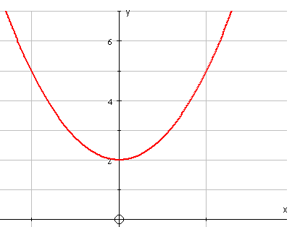
Areas
Definite integration results in a value.
It can be used to find an area bounded, in part, by a curve
e.g.
gives the area shaded on the graph
The limits of integration . . .
0
1

Slide 5
Areas
Definite integration results in a value.
It can be used to find an area bounded, in part, by a curve
1
e.g.
gives the area shaded on the graph
0
The limits of integration . . .
. . . give the boundaries of the area.
x = 0 is the lower limit
( the left hand boundary )
x = 1 is the upper limit
(the right hand boundary )
0
1

Slide 6
Finding an area
Since
y
=
3
x
2
+
2
the shaded area equals 3
0
1
The units are usually unknown in this type of question

Slide 7
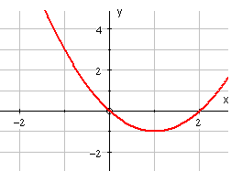
Finding an area
A
B
For parts of the curve below the x-axis, the definite integral is negative, so

Slide 8
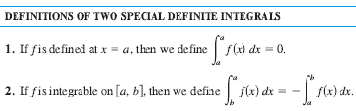

Slide 9

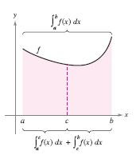

Slide 10
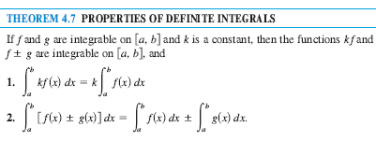


Slide 11


Slide 12
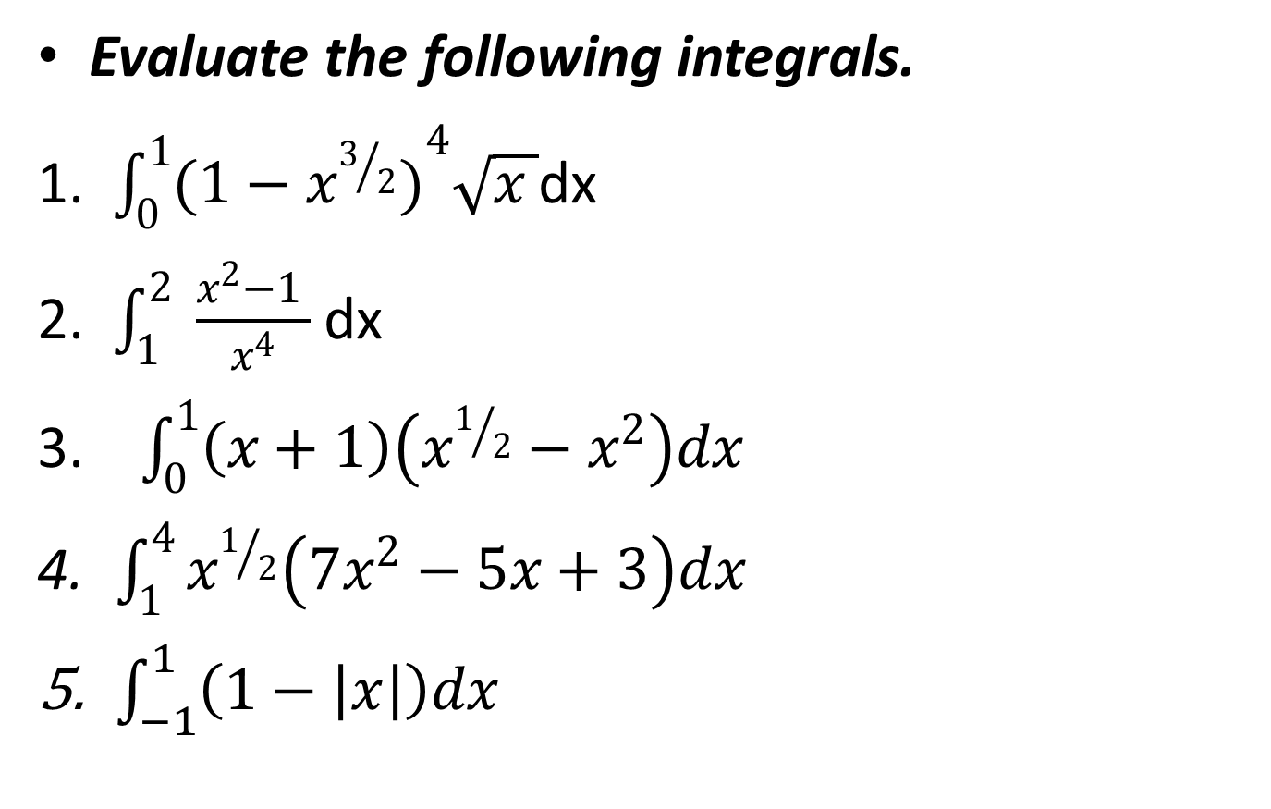
EXAMPLE

Slide 13
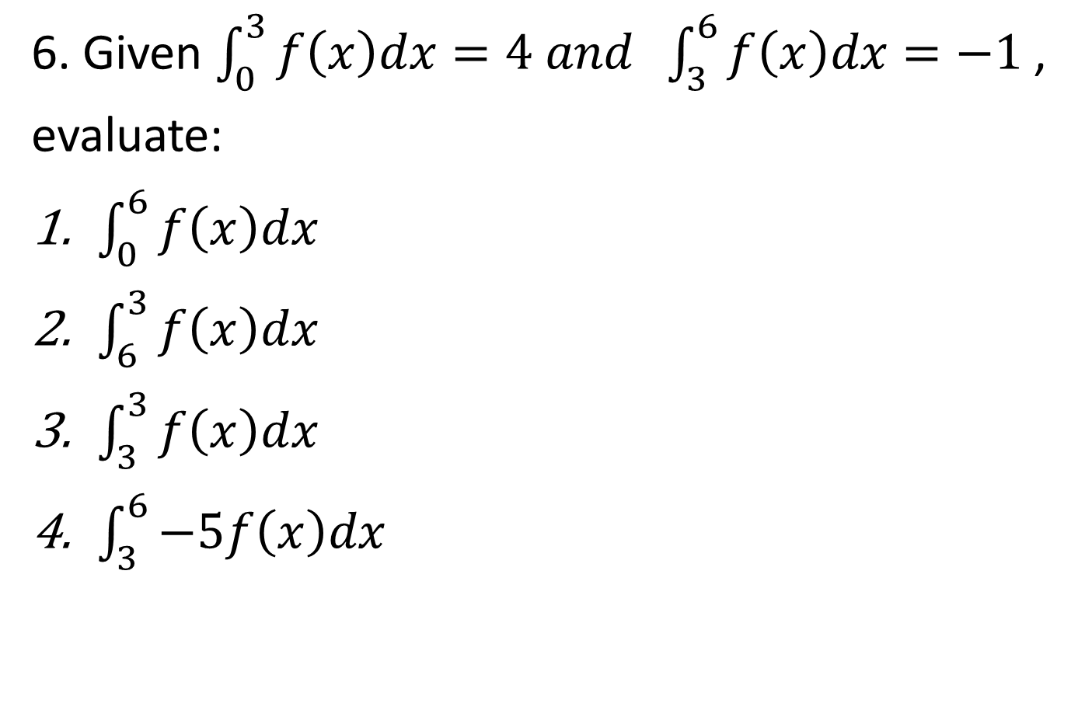

Slide 14


EXERCISES

Slide 15
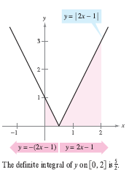


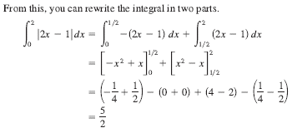
INTEGRATION OF ABSOLUTE VALUE FUNCTION

Slide 16
INTEGRATION OF ABSOLUTE VALUE FUNCTION
EXAMPLE
1st solution
-2
-1
0
1
2
3
4

Slide 17
2nd solution
(4,4)
(-2,2)
-2
-1
0
1
2
3
4

Slide 18
1st solution

Slide 19
2nd solution
(-3,4)
(3,2)
-3
-2
-1
0
1
2
3

Slide 20


EXERCISES

Slide 21
INTEGRATION OF ODD AND EVEN FUNCTIONS
The graph of an even function is symmetric about the y-axis.
The graph of an odd function is symmetric about the origin.

Slide 22
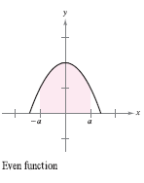
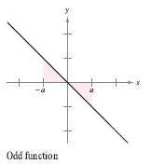

Slide 23
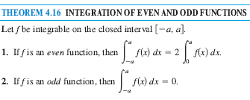

Slide 24

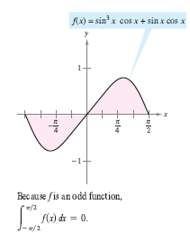


EXAMPLE

Slide 25
INTEGRATION OF PIECEWISE FUNCTION
EXAMPLE
solution

Slide 26
EXERCISES

Slide 27
EXERCISES

Slide 28
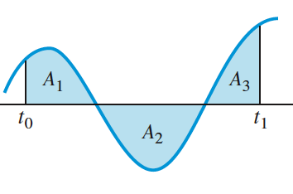
Area =0.8
Area =1.5
a
b
c
d
Area =2.6

Slide 29
Answers :

Slide 30
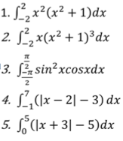
OTHER EXAMPLE
Find the definite integral of the following

Slide 31
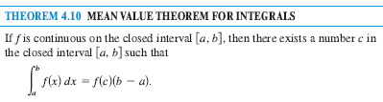
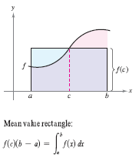
The mean value theorem for integrals state that somewhere “between” the inscribed and the circumscribed rectangles there is a rectangle whose area is precisely equal to the area of the region under the curve.

Slide 32


EXRCISES
Find the value(s) of c guaranteed by the Mean Value Theorem for Integrals for the function over the given interval.

Slide 33
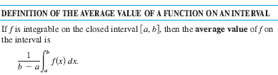

Slide 34
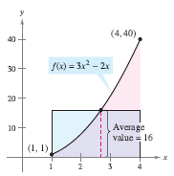
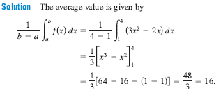

Slide 35
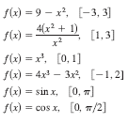
EXRCISES
Find the average value of the function over the given interval.

